Slide 1

Title Slide
Title: Contract Monthly Claim System (CMCS)
Subtitle: POE Part 3
Your Name: Matshidiso Nthebe
Student NR: ST10449727
Course: PROG6212 - Programming 2B

Slide 2

Problem Statement & Vision
The Current Challenge:
Manual, paper-based claim submission process
Time-consuming and prone to errors
Lack of transparency in approval status
Difficult tracking and reporting
Our Vision:
Digital, automated web-based platform
Streamlined approval workflow
Real-time status tracking
Enhanced transparency and efficiency

Slide 3
Key Stakeholders & User Roles
User Roles:
Lecturer: Submits claims, tracks status, uploads documents
Programme Coordinator: Reviews and validates claims
Programme Manager: Final approval/rejection authority
HR Department: Payment processing and data management
Stakeholders:
Students (Developers)
Academic Staff (End Users)
Module Coordinator (Supervisor)

Slide 4

System Architecture & Technology Stack
Frontend:
ASP.NET Core Razor Pages
HTML5, CSS3, JavaScript
jQuery for client-side operations
Backend:
C# with ASP.NET Core (.NET 6/7)
Entity Framework Core
ASP.NET Core Identity
Database:
Microsoft SQL Server
Tools:
Git/GitHub for version control
Visual Studio 2022

Slide 5
Enhanced Features - Lecturer View
Automation Features:
Auto-calculation: Total amount computed in real-time
Validation checks: Data integrity enforcement
Document upload: Supporting evidence attachment
Status tracking: Real-time claim progress monitoring
Technical Implementation:
jQuery for client-side calculations
Entity Framework for data persistence
ASP.NET Core model validation

Slide 6
Enhanced Features - Approval Workflow:
Programme Coordinator & Manager:
Dashboard view: All pending claims in one place
Quick actions: Approve/Reject with comments
Policy validation: Automatic criteria checking
Audit trail: Complete history with timestamps
Technical Implementation:
FluentValidation for business rules
Role-based authorization
Status-driven workflow engine

Slide 7
Enhanced Features - HR & Reporting
HR AutomaLecturer management: Update personal information
Reporting: Automated payment summaries
Invoice generation: Ready for payment processing
Data security: Role-based access control
Technical Implementation:
- LINQ queries for data aggregation
- Razor Pages for report generation
- ASP.NET Identity for user management

Slide 8
System Workflow
End-to-End Process:
1. Lecturer registration and login
2. Claim submission with auto-calculation
3. Coordinator review and validation
4. Manager final approval
5. HR processing and reporting
6. Continuous status tracking throughout

Slide 9
Database Design
AspNetUsers` - User accounts and roles
`Claims` - Claim submissions and status
`SupportingDocuments` - File attachments
`ApprovalHistory` - Audit trail records

Slide 10
Project Timeline (8 Weeks)
Development Phases:
Week 1-2: Project setup & database design
Week 3-4: Authentication & claim submission
Week 5-6: Approval workflows & tracking
Week 7-8: Testing, deployment & documentation
Agile Methodology:
Iterative development
Weekly progress reviews
Continuous integration

Slide 11
Risk Management
Identified Risks & Mitigation:
Technical complexity: Comprehensive research & tutorials
Database issues: Backup strategy & testing
Security concerns: Validation & role-based access
Timeline delays: Weekly planning & version control

Slide 12

Key Benefits & Impact
Operational Benefits:
80% faster claim processing
Reduced errors with automated calculations
Full transparency in approval process
Better reporting and audit capabilities
User Experience:
Intuitive and user-friendly interface
Mobile-responsive design
Real-time notifications
Secure data handling

Slide 13

Future Enhancements
Planned Improvements:
Email notifications for status changes
Mobile application development
Advanced analytics dashboard
Integration with financial systems
Multi-language support

Slide 14
Demonstration
Live Demo Highlights:
User registration and login
Claim submission with auto-calculation
Approval workflow demonstration
Status tracking and reporting
HR management features

Slide 15
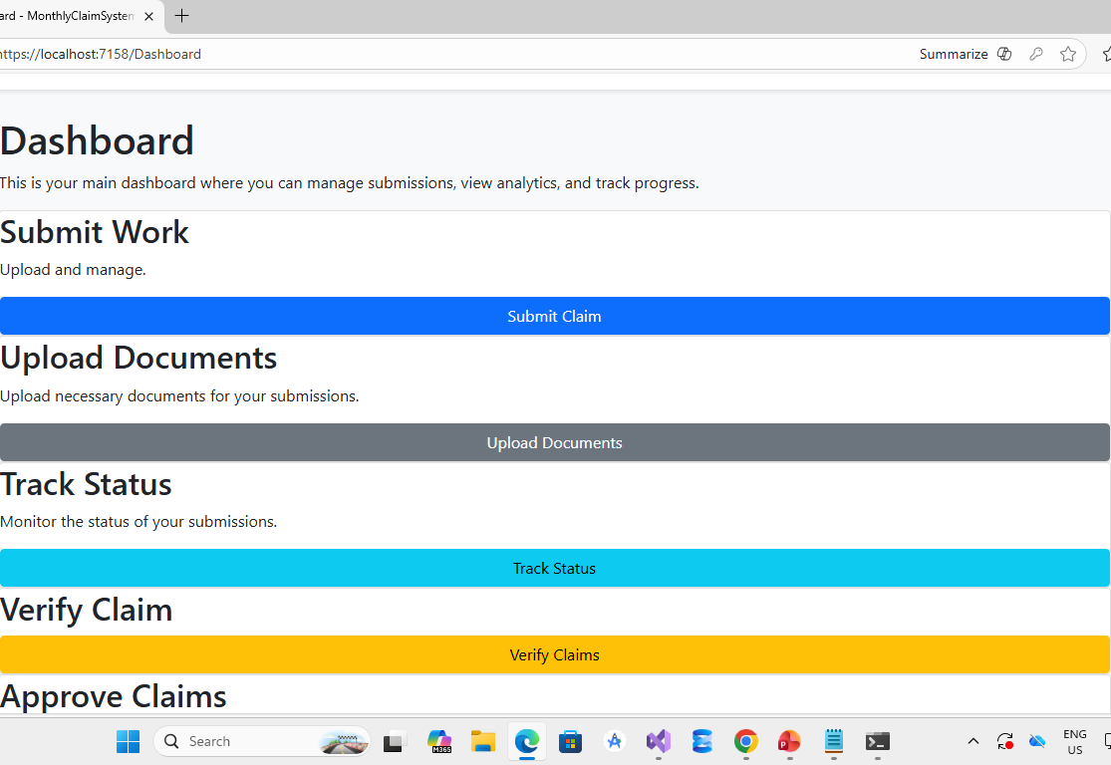

Slide 16
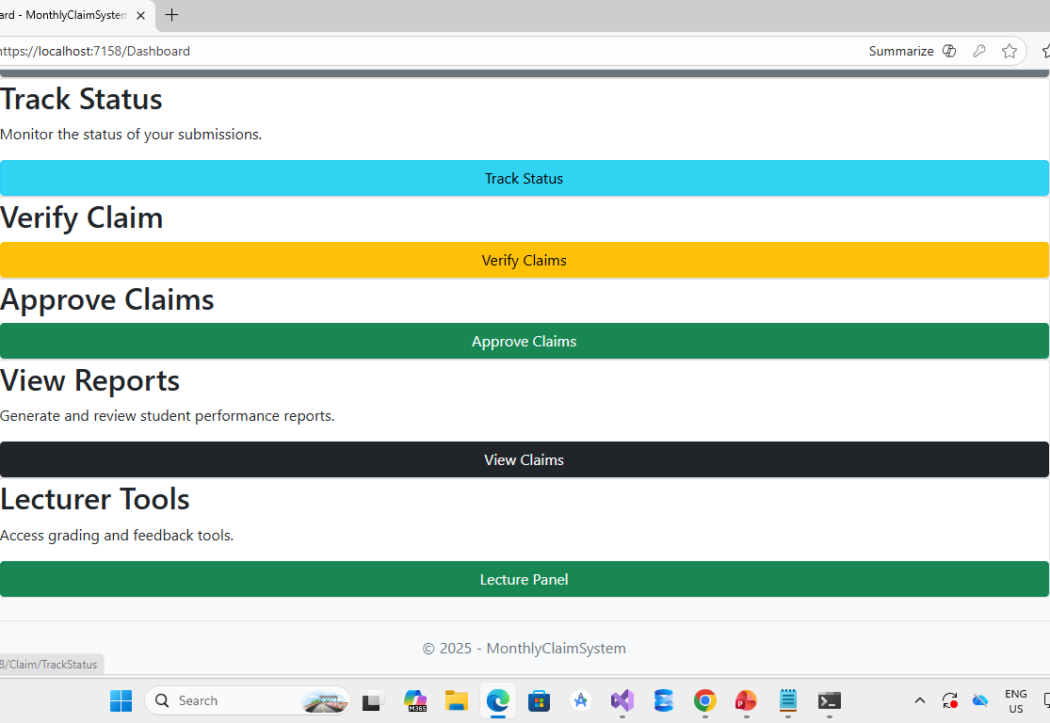

Slide 17
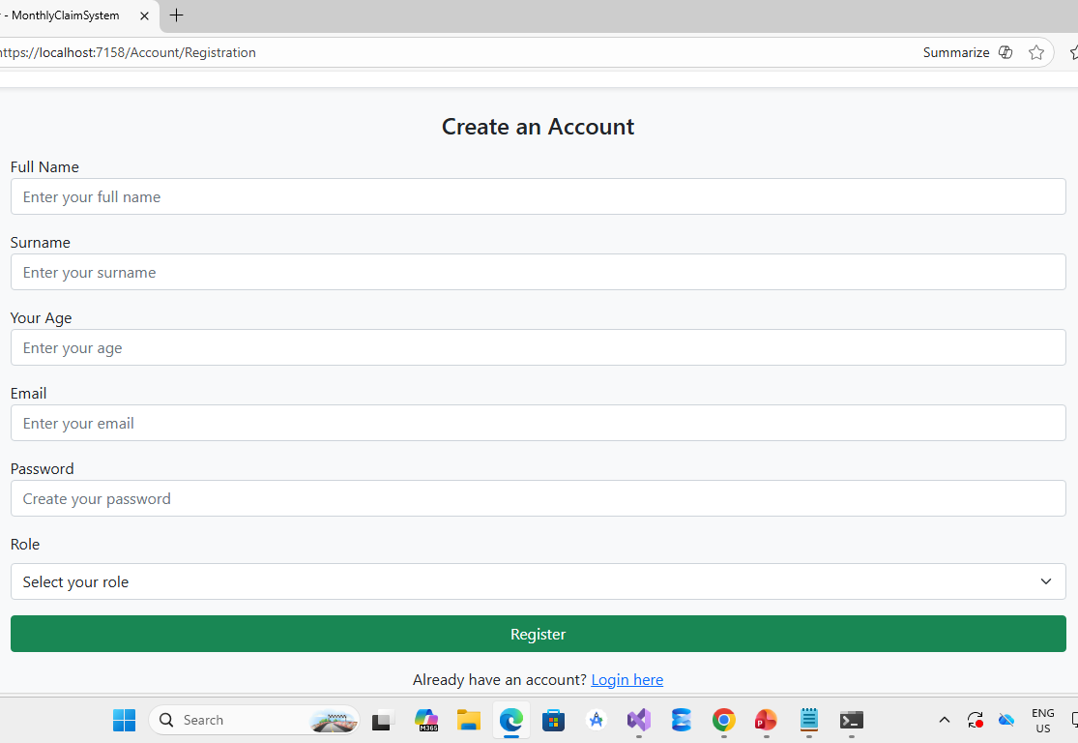

Slide 18
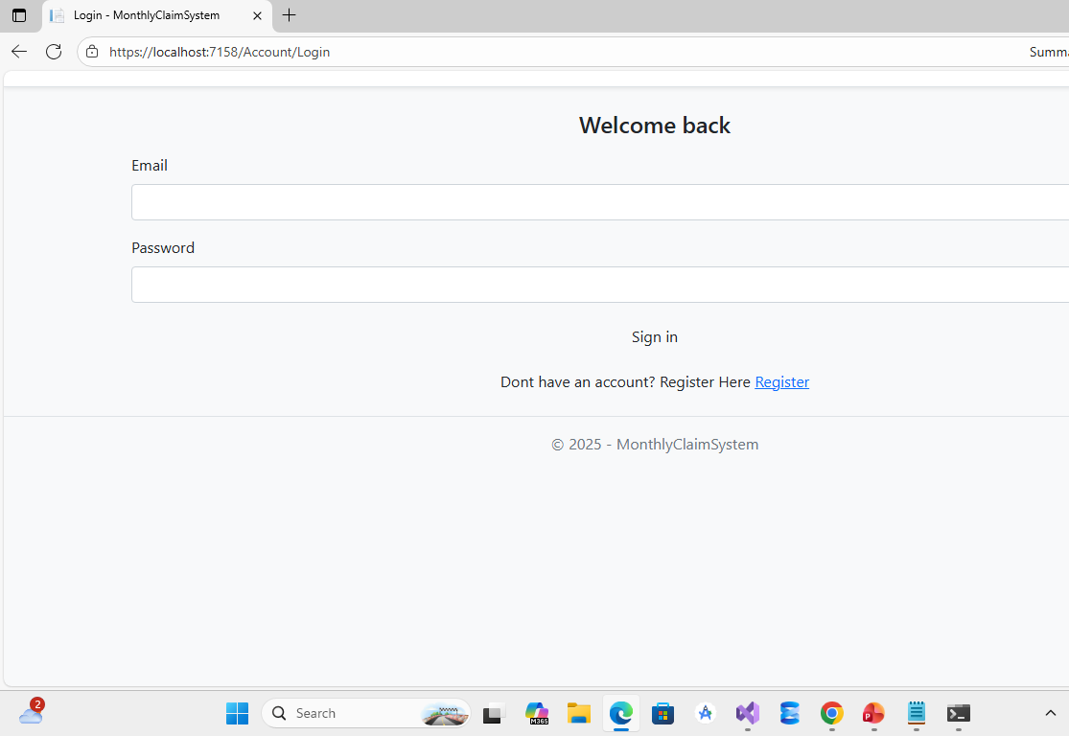

Slide 19
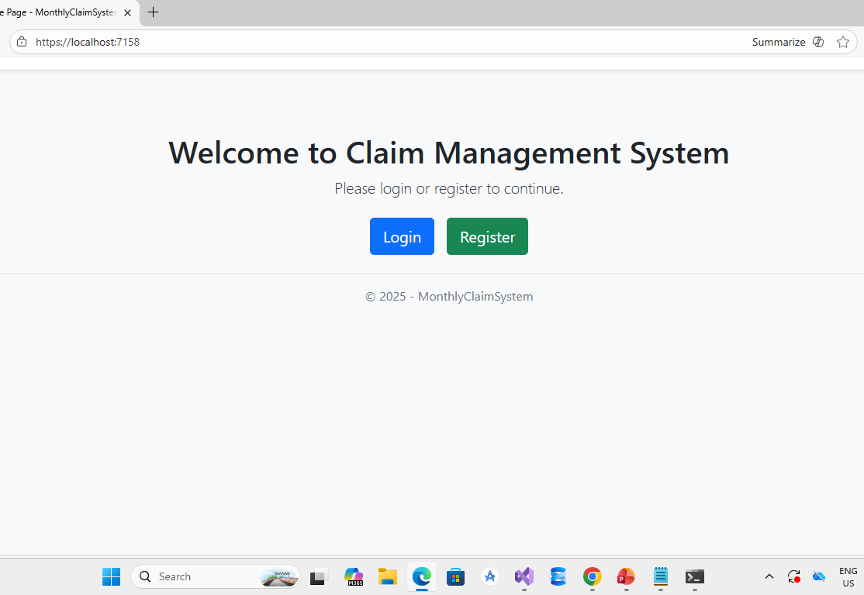

Slide 20
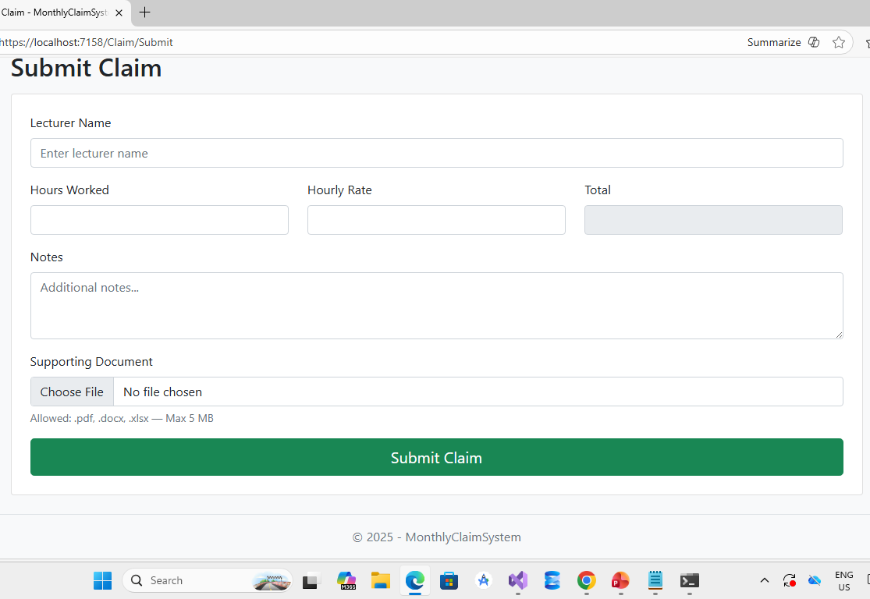

Slide 21
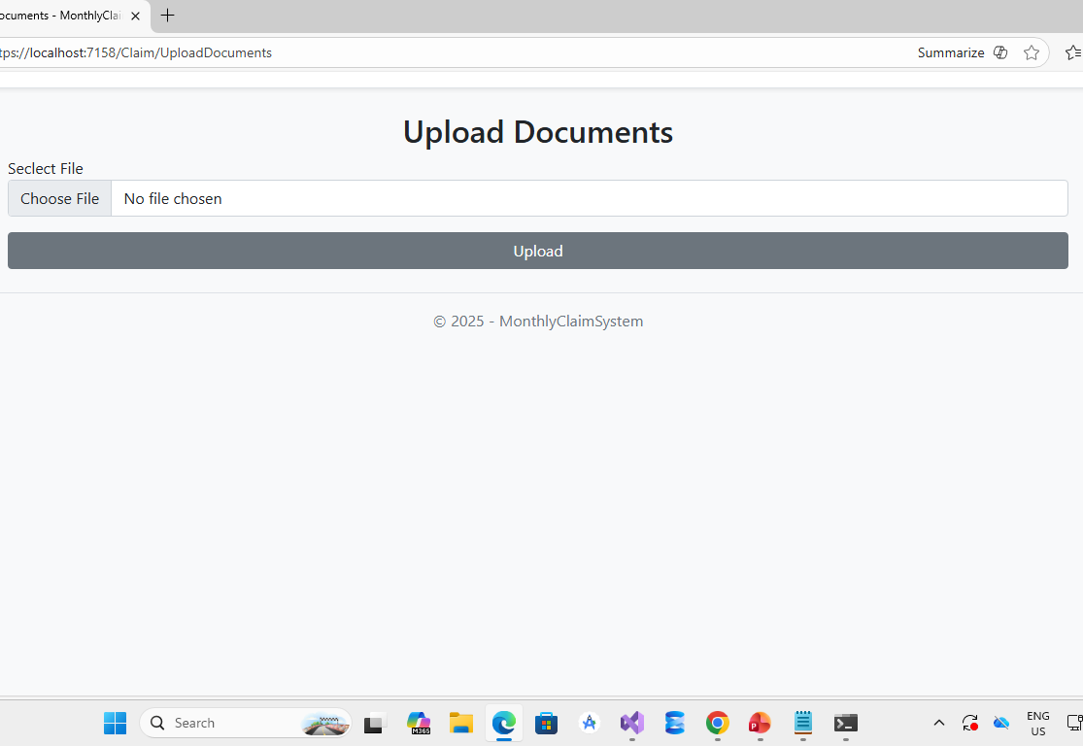

Slide 22
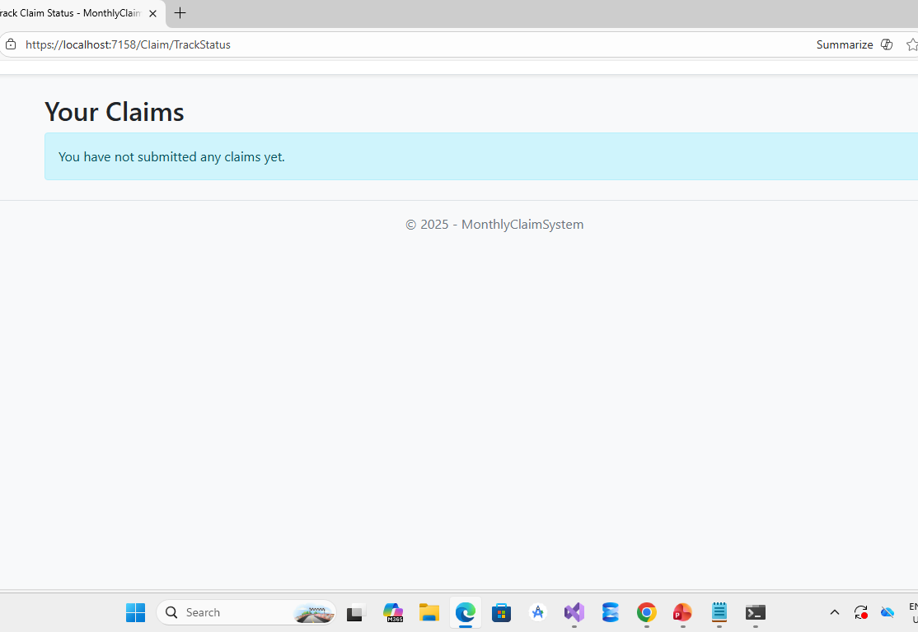

Slide 23
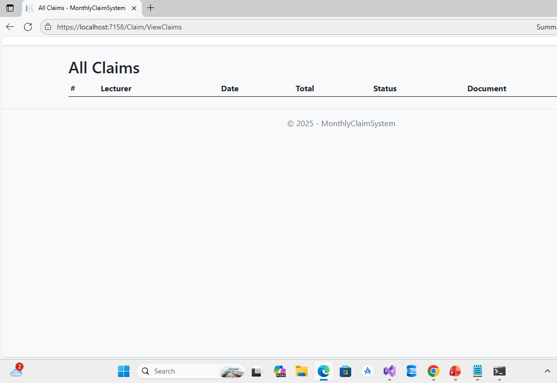

Slide 24
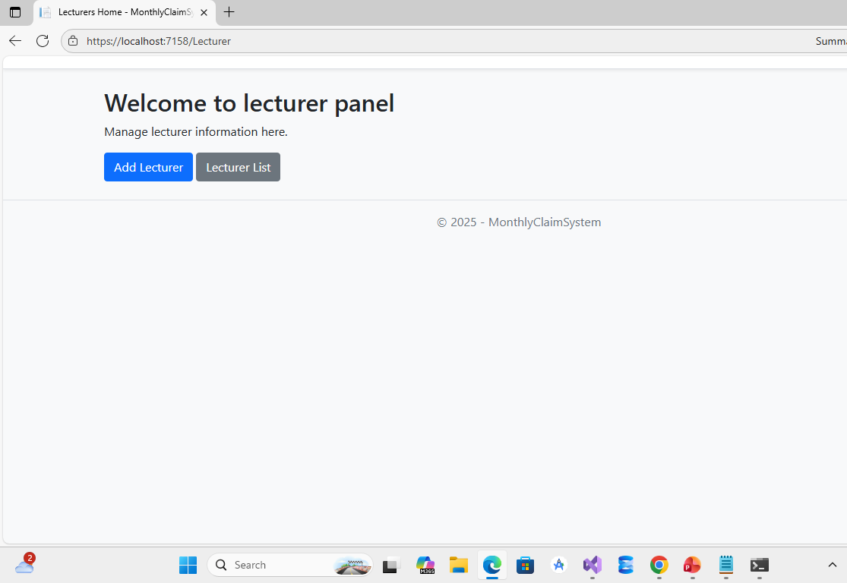

Slide 25

Conclusion & Q&A
Project Success:
All objectives achieved
Fully functional system delivered
Positive user feedback
Robust and scalable architecture
Thank You!
Questions & Answers

Slide 26
Reference list
1. Microsoft. (2023). ASP.NET Core Documentation. Retrieved from
<https://learn.microsoft.com/aspnet/core>
2. Microsoft. (2023). SQL Server Documentation. Retrieved from
<https://learn.microsoft.com/sql>
3. GitHub. (2023). Version Control with Git. Retrieved from
<https://docs.github.com/>
4. ISO/IEC. (2018). ISO/IEC 25010:2018 Systems and software engineering --- System and software quality models.
5. Sommerville, I. (2016). Software Engineering (10th ed.). Pearson.
6. Pressman, R. S., & Maxim, B. R. (2020). Software Engineering: A Practitioner's Approach (9th ed.). McGraw-Hill.
7. Draw io https://app.diagrams.net/?src=about#
8. xUnit Project. (2023). xUnit.net Documentation. Retrieved from <https://xunit.net/>

